Slide 1
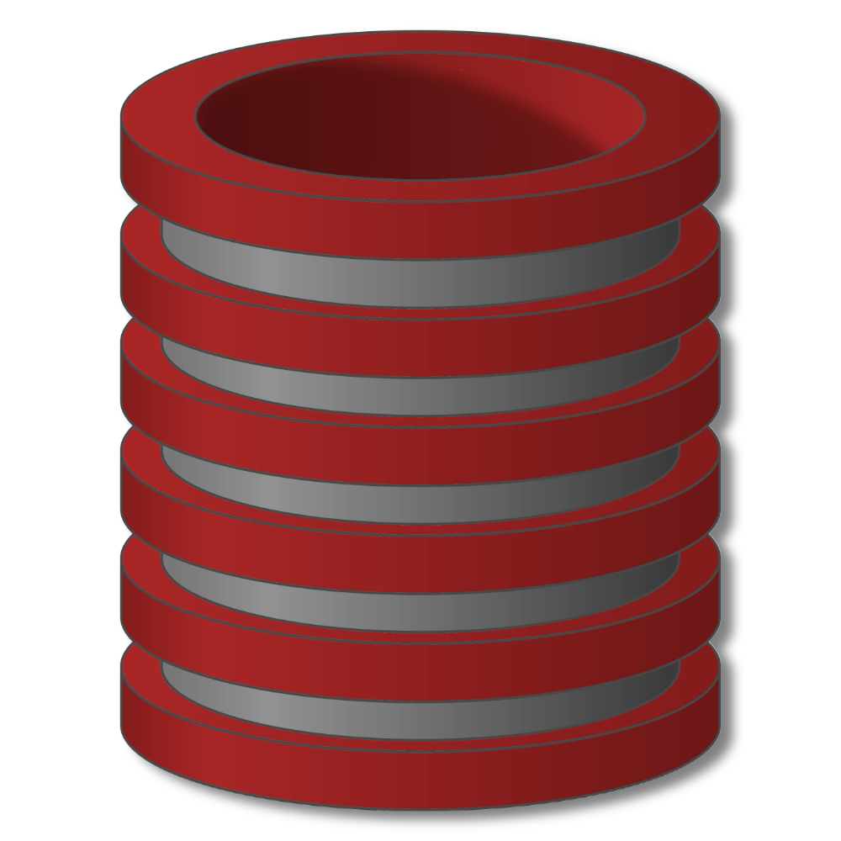
Constraints & Triggers
Motivation and overview

Slide 2
Constraints & Triggers
Constraints and Triggers
For relational databases
SQL standard; systems vary considerably
(Integrity) Constraints
constrain allowable database states
Triggers
monitor database changes,
check conditions and initiate actions

Slide 3
Constraints & Triggers
Integrity Constraints
Impose restrictions on allowable data, beyond those
imposed by structure and types
Examples

Slide 4
Constraints & Triggers
Integrity Constraints
Impose restrictions on allowable data, beyond those
imposed by structure and types
Why use them?

Slide 5
Constraints & Triggers
Integrity Constraints
Impose restrictions on allowable data, beyond those
imposed by structure and types
Classification

Slide 6
Constraints & Triggers
Declaring and enforcing constraints
Declaration
With original schema
Or later
Enforcement
Check after every modification
Deferred constraint checking

Slide 7
Constraints & Triggers
Triggers
“Event-Condition-Action Rules”
When event occurs, check condition; if true, do action
Examples

Slide 8
Constraints & Triggers
Triggers
“Event-Condition-Action Rules”
When event occurs, check condition; if true, do action
Why use them?

Slide 9
Constraints & Triggers
Triggers in SQL
“Event-Condition-Action Rules”
Create Trigger name
Before|After|Instead Of events
[ referencing-variables ]
[ For Each Row ]
When ( condition )
action

Slide 10
Constraints & Triggers
Constraints and Triggers
For relational databases
SQL standard; systems vary considerably
(Integrity) Constraints
constrain allowable database states
Triggers
monitor database changes,
check conditions and initiate actions

